Slide 1
Writing Readable & Maintainable Code (Java)
Reference: Text Book Clean Code

Slide 2
Learning Objectives
Understand the philosophy of Clean Code
  Write intention-revealing names
  Design small, focused functions
  Write meaningful comments
  Perform structured code reviews
  Refactor bad code into clean code

Slide 3
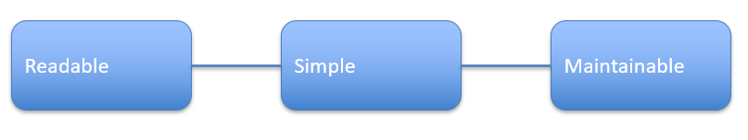
The Cost of Bad Code
Technical debt slows development
  Quick fixes accumulate complexity
  Messy code increases bug probability
  Maintenance cost > Development cost
Clean Code Mindset

Slide 4
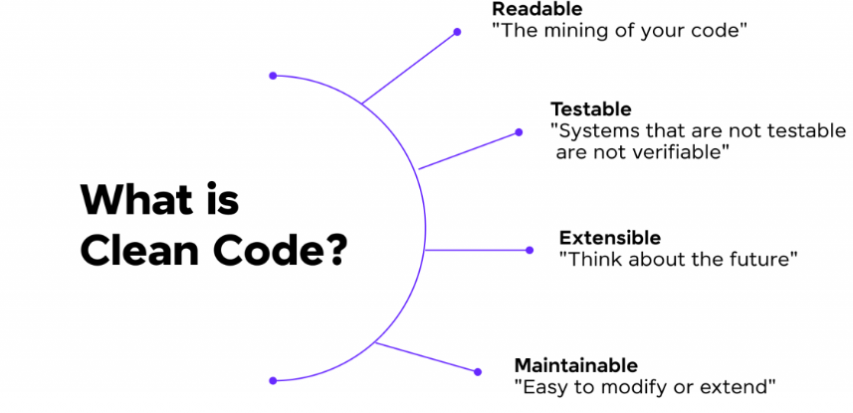
Clean Code Definition
Readable and simple
Focused and minimal
No duplication
Clear intent
Testable and maintainable

Slide 5
Bad Code Example – Hard to Understand
public void p(int t){
if(t==1){System.out.println("Approved");}
else{System.out.println("Rejected");}
}
Refactored Version – Clear Intent
public void printApplicationStatus(int statusCode) {
if (statusCode == APPROVED) {
System.out.println("Approved");
} else {
System.out.println("Rejected");
}
}

Slide 6
Discussion Question
Which version is easier to maintain?
  What happens if we add more statuses?
  How would testing differ?

Slide 7
Meaningful Names
Names should reveal intent
  Avoid vague names (data, temp, value)
  Avoid misleading names
  Use searchable names
  Use consistent naming

Slide 8
Poor vs Improved Naming Example
Poor | Improved
int d; int m; List list1; | int elapsedTimeInDays; int monthlyInterestRate; List<Student> registeredStudents;

Slide 9
Advanced Naming Principle
Avoid mental mapping (i, j, x)
Use domain terminology (Domain – Banking System)
Mental Mapping Required | Intent-Revealing Name
int d; d = 30; if (d > 18) { System.out.println("Eligible"); } | int userAge = 30; if (userAge > 18) { System.out.println("Eligible"); }
Generic Naming | Domain Language
double value = calculate(x); | double monthlyInterest = calculateMonthlyInterest(accountBalance);

Slide 10
Advanced Naming Principle
Be consistent across project
Replace magic numbers with constants
Inconsistent Naming | Consistent Naming
int userAge; int customer_age; int ClientAge; | int userAge; int customerAge; int clientAge;
Magic Number Problem | Using Constant
if (passwordLength < 8) { System.out.println("Password too short"); } | private static final int MIN_PASSWORD_LENGTH = 8; if (passwordLength < MIN_PASSWORD_LENGTH) { System.out.println("Password too short"); }

Slide 11
Java Naming Conventions
  Class: PascalCase (StudentRecord)
  Method: camelCase (calculateTotal)
  Variable: camelCase (totalMarks)
  Constant: UPPER_CASE (MAX_LIMIT)

Slide 12
Functions
Functions should be small
  Do one thing only
  Reduce nesting
  Use descriptive names
  Limit number of parameters

Slide 13
Bad Function – Multiple Responsibilities
public void processOrder(Order o){
validate(o);
calculateTotal(o);
printInvoice(o);
saveToDatabase(o);
}

Slide 14
Problem Analysis
Hard to test individually
  Tightly coupled responsibilities
  Difficult to reuse components

Slide 15
Refactored Version
public void processOrder(Order order) {
validateOrder(order);
double total = calculateOrderTotal(order);
generateInvoice(order, total);
saveOrder(order);
}

Slide 16
Comments
Good code reduces the need for comments
  Explain WHY, not WHAT
  Avoid redundant comments
  Remove outdated comments

Slide 17
Bad Comment Example
int count = 5; // assign 5 to count

Slide 18
Good Comment Example
// Maximum retry attempts before locking account
private static final int MAX_RETRY_ATTEMPTS = 3;

Slide 19
Types of Useful Comments
Legal comments
  Warning comments
  TODO comments
  Clarification of complex algorithms

Slide 20
What is Code Review?
Process of examining code to:
  Detect bugs
  Improve quality
  Improve readability
  Ensure standards

Slide 21
Code Review Checklist
Are names meaningful?
  Are functions small?
  Any duplication?
  Any magic numbers?
  Comments useful and minimal?
  Formatting consistent?

Slide 22
Personal Review
✔ Developer reviews own code
✔ Checks logic
✔ Removes unused variables
✔ Fixes formatting
Example Checklist:
  Are variable names meaningful?
  Any duplicate code?
  Edge cases handled?

Slide 23
Peer Review
✔ Another developer reviews your code
✔ Fresh perspective
✔ Finds hidden mistakes
Benefits:
  Knowledge sharing
  Team consistency
  Better quality

Slide 24
Code Review Activity
Identify the following on the given code:
Naming issues
  Formatting problems
  Runtime error (Division by zero)
  Refactoring suggestions
public class test{
public static void main(String[]args){
int a=100;
int b=0;
System.out.println(a/b);}}

Slide 25
Final Takeaways
Clean code is a professional responsibility
  Good names improve readability instantly
  Small functions reduce complexity
  Comments should add value
  Code review prevents future bugs

